Slide 1
Italy
By Michelah Boucher

Slide 2
The history of Italy
Italy it the heart of southern Europe for years.
Italy is most famous for the boot shape.
Italy didn’t get in the middle of world war II.
But they did help some.

Slide 3
Geography of Italy
The capital of Italy is Rome.
The biggest mountain in Italy is Mont Blanc.
It is 15,781 feet long.
The longest river is PO.
It is 405 miles long.

Slide 4
Culture of Italy
93% of Italy language speaks an Italian
The population of Italy is 58,057,477.
They use Euro for money.
95% speaks Italian.
Climate predominantly Mediterranean; Alpine in far north; hot, dry in south

Slide 5
Politics of Italy
The government is republic
The president of Italy is Giorgio Napolitano
http://www.reuters.com/article/2014/03/31/us-italy-politics-idUSBREA2U0KA20140331

Slide 6
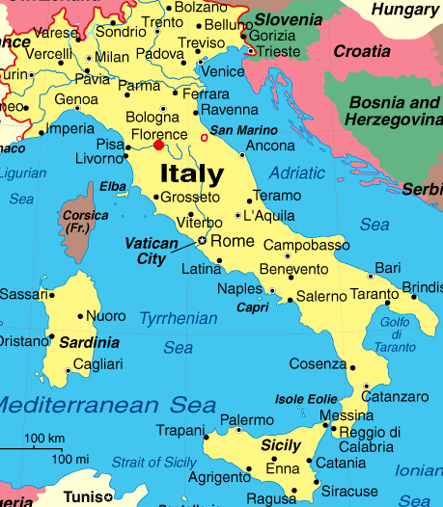
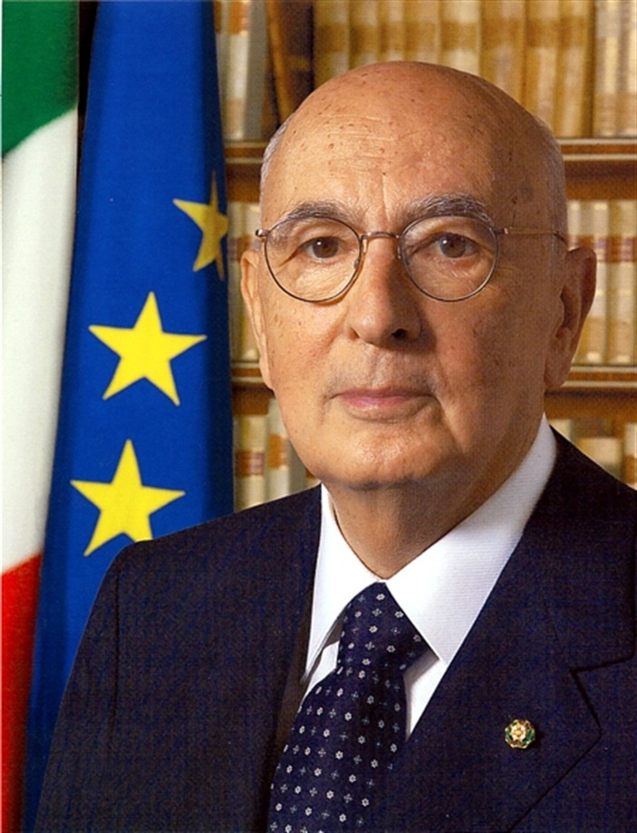
Pictures of Italy

Slide 7
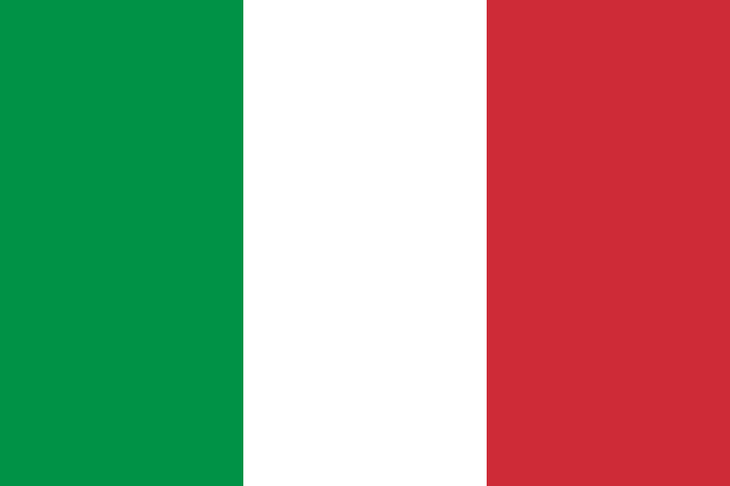
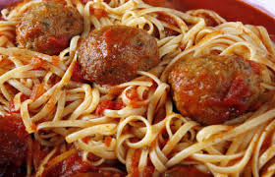
Pictures
This is the flag of Italy and foods

Slide 8
Web siting
http://www.infoplease.com/country/italy.html?pageno=2
http://www.softschools.com/timelines/italy_history_timeline/150/
http://www.kwintessential.co.uk/resources/global-etiquette/italy-country-profile.html

