Slide 1
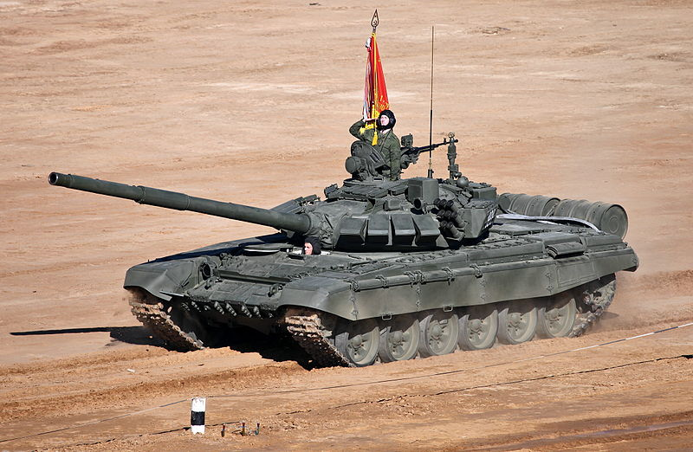
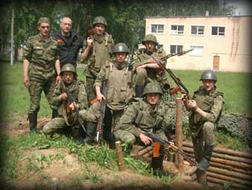
Russian Army
BY
Noah Brown

Slide 2
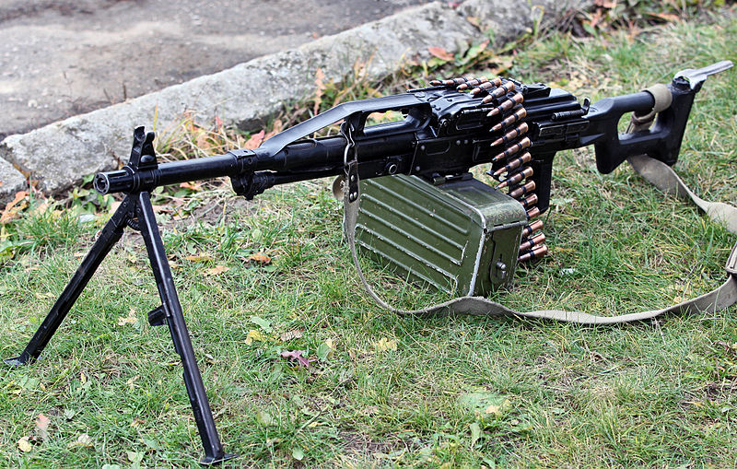
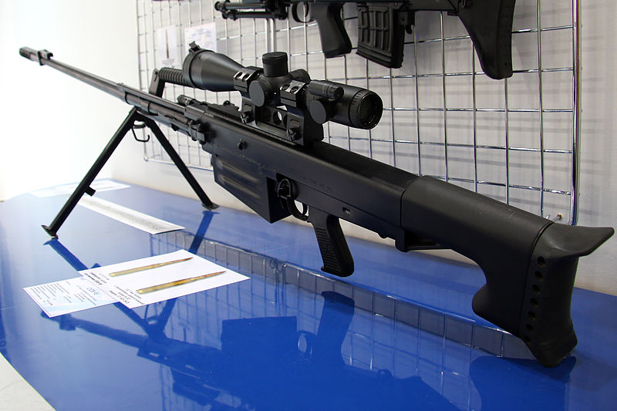
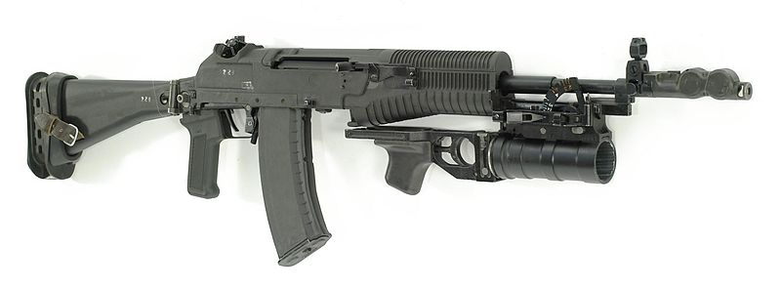
Russian Weapons
Russian forces don’t mess around with people they have lots of military weapons and vehicles like tanks, sniper rifles and machine guns. Most guns are made out of metal.

Slide 3
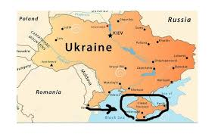
Ukraine crisis
President Putin sent Russian troops into Ukraine to take over part of it.

Slide 4
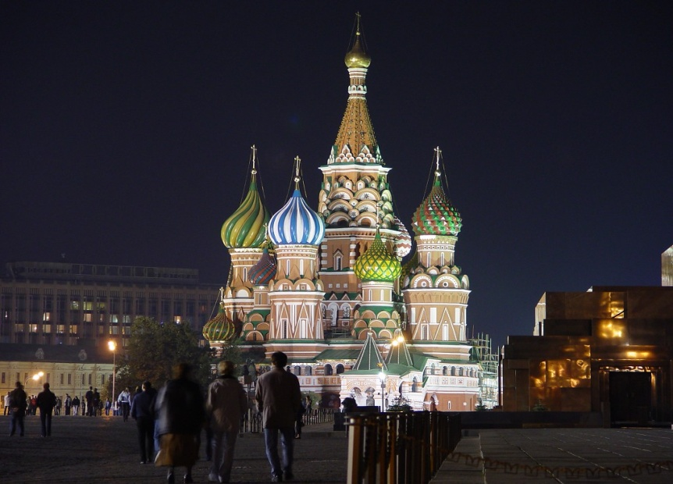
Russian haunts
The Kremlin haunted by former Soviet leaders that died in a battle with the Japanese.

